Slide 1

Department of Computer Science and Engineering
Final Project
AUTOMATICALLY IDENTIFYING ANIMALS USING SINGLE SHOT DETECTION
Batch:D16
YASHRAJ PANDEY:-191061101214
SRIKANT.M:-191061101184
S SURANPAL SINGH BALI:-191061101189
SUPERVISOR :- Mrs O.VASANTHA KUMARI

Slide 2
Abstract
Agriculture is the most important sector of Indian Economy but the issue of damage to crops by wild animals has turned into an important social issue in current occasions. So far, many of the farmers reply on guards to guard their crops which increases the overhead costs. But, due to current climate conditions, crop failure rate has increased dramatically. Debt in agricultural sector has increased tremendously. In these situations, a farmer cannot expect further destruction of crops and neither can afford increase costs in farming.

Slide 3
INTRODUCTION
Agriculture meets the food demands of the population and also provides various raw materials for different industries. Interference of animals in agricultural lands causes a huge loss of crops. Crop damage due to raiding wild animals has become a major issue of concern these days. Animals like wild boars, macaques, porcupines, deer, monkeys and bears are extremely destructive and have also caused human casualties in certain occasions. Small farmers can even lose up to half of their yield to animals and they cannot take any harsh measures due to the strict wildlife laws. Human-elephant conflict is rising intensely as elephants are a highly conflict prone wildlife species, especially in India. Thus, there is need for a system to detect any intrusion which can help the farmers to drive away these animals as soon as they learn about their intrusion.

Slide 4
Computer vision is applicable to many fields like medical field, robotics, remote sensing, machine vision, content-based image retrieval. Computer vision solves many problems in different disciplines. Computer vision also applied in the security field to perform automatic surveillance and access control and attendance management.
The computer vision can be applied in agriculture field in many ways like disease detection of a tree by examining leaves or flowers or fruits and quality control of agricultural products.
The computer vision techniques can be applied in order to provide security from wild animals in agriculture. In agriculture fields near to forest areas have a severe threat from wild animals, which attacks regularly on farms.
These attacks causing huge damage to agricultural crops subsequently causes significant financial losses to farmers.

Slide 5
Literature review:
S. NO | Journal Type with year | Authors | Title | Outcomes
1 | International Journal of Computational Intelligence Research (2017) | Nagaraju Andavarapu and Valli Kumari Vatsavayi | Wild-Animal Recognition in Agriculture Farms Using W-COHOG for Agro-Security | Fundamentals of Computer Vision and Object detection in any image.
2 | Proceedings of the Second International Conference on Inventive Research in Computing Applications. (2020) | S. Yadahalli, A. Parmar and A. Deshpande | Smart Intrusion Detection System for Crop Protection by using Arduino | Use of AI and motion sensor for an intrusion detection system.

Slide 6
S. NO | Journal Type with year | Authors | Title | Outcomes
3 | Google Inc. (2017) | Howard, Andrew & Zhu, Menglong & Chen, Bo & Kalenichenko, Dmitry & Wang, Weijun & Weyand, Tobias & Andreetto, Marco & Adam, Hartwig | MobileNets: Efficient Convolutional Neural Networks for Mobile Vision Applications | SSD model MobileNet which can work on low performance hardware.
4 | International Journal of Science and Research. (2016) | Abhinav V. Deshpande | Design and Implementation of an Intelligent Security System for Farm Protection from Wild Animals | Animal detection and protection of crops in embedded settings.

Slide 7
Existing method:
Since most of the farms in India are small, most farmers relies on medieval techniques like using a scare crow, or relying on guards to monitor crops.
More recently, crops are also being protected using electric fencing but it can be highly cost inefficient which a small farmer cannot afford.
Even if they can afford it, in most cases it is illegal to use such fences which governments uses as a measure to conserve the wildlife populations.
In busy seasons like the harvesting time, it can get difficult to have a guard, guarding and monitoring the crops from animals.

Slide 8
Disadvantages in Existing method:
High cost.
Prone to seasonality.
Are highly inefficient.
Requires costly equipments and infrastructure.

Slide 9
Proposed System:
AI based surveillance system to detect and monitor the presence of any animal.
Camera can be placed conveniently at location(s) where any possible animal might enter from.
The system uses computer vision using Open CV to process the feed from the camera.
Pre-trained model Mobile Net SSD (Single Shot Detector) is used to detect the animals in the farms. The model is trained on MS COCO image dataset.
Siren is fired on detecting an animal which can act as a deterrent to the animal.
It can also notify the farmer so that he/she can take the concerned action as required in time.

Slide 10
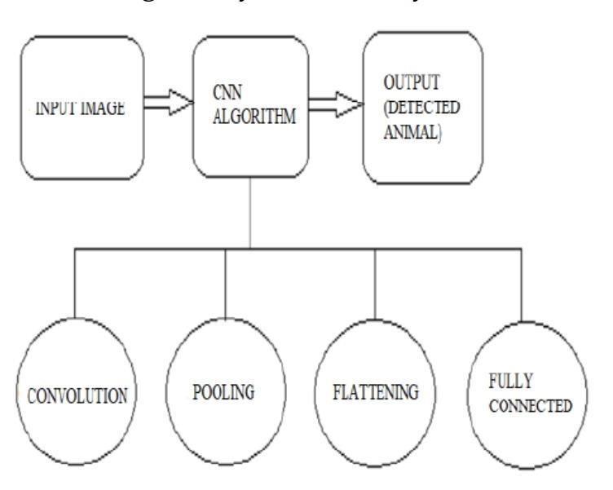
Architecture of proposed method :

Slide 11
Advantages of Proposed method:
Lower cost to operate.
Seasonality does not affect at all.
Does not require very high performance or costly hardware(s).
Are very efficient.

Slide 12
UML DIAGRAMS USE CASE DIAGRAM :
A use case diagram in the Unified Modelling Language (UML) is a type of behavioural diagram defined by and created from a Use-case analysis.
It’s purpose is to present a graphical overview of the functionality provided by a system in terms of actors, their goals (represented as use cases), and any dependencies between those use cases.
The main purpose of a use case diagram is to show what system functions are performed for which actor. Roles of the actors in the system can be depicted.

Slide 13

Train the model
Loads the video
Captures video live
System
Detect objects
User
Views detected objects
Plays the siren
Stops the video
Stops video capture and siren

Slide 14
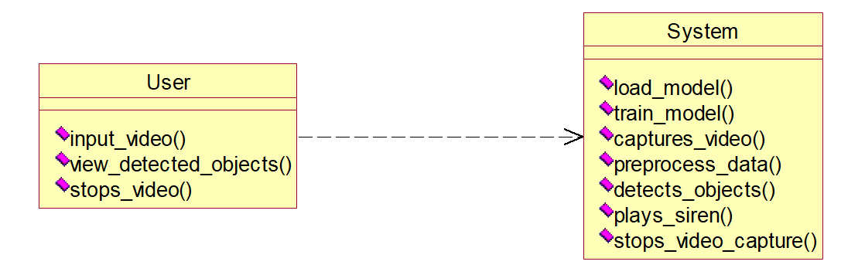
CLASS DIAGRAM:
In software engineering, a class diagram in the Unified Modeling Language (UML) is a type of static structure diagram that describes the structure of a system by showing the system's classes, their attributes, operations (or methods), and the relationships among the classes. It explains which class contains information.

Slide 15
ACTIVITY DIAGRAM :
Activity diagrams are graphical representations of workflows of stepwise activities and actions with support for choice, iteration and concurrency. In the Unified Modeling Language, activity diagrams can be used to describe the business and operational step-by-step workflows of components in a system. An activity diagram shows the overall flow of control.

Slide 16
SEQUENCE DIAGRAM:
A sequence diagram in Unified Modeling Language (UML) is a kind of interaction diagram that shows how processes operate with one another and in what order. It is a construct of a Message Sequence Chart. Sequence diagrams are sometimes called event diagrams, event scenarios, and timing diagrams.

Slide 17








system
user
Load model
Train model
Inputs the video
Capture video
Preprocess
Detects objects
Plays siren
Stops video feed

Slide 18
Hardware and Software Requirement:
Operating System: Windows 7+
RAM: 4GB minimum.
Processor: i3 (min)
Hard Disk: 128 GB +
Python v3.6+

Slide 19
CONCLUSION :
The problem of damaging crops by wild animals has become a major social problem in the current time. It requires urgent attention and an effective solution. The proposed method allows us to detect any animal presence or intrusion in farms using video from any camera device placed in the farms. The object detection model worked almost consistently at 18 frames per second.
It is a cheap and robust system. The siren scares the intruders away as well as it can alert the farmer to act. Thus, this application can be used to protect crops in the farm. It might be very useful for agricultural purposes instead of traditional methods used today.

Slide 20
REFERENCES
[1] Parikh, M. et al. “Wild-Animal Recognition in Agriculture Farms Using W-COHOG for Agro-Security.” (2017).
[2] S. Yadahalli, A. Parmar and A. Deshpande, "Smart Intrusion Detection System for Crop Protection by using Arduino," 2020 Second International Conference on Inventive Research in Computing Applications (ICIRCA), Coimbatore, India, 2020, pp. 405-408, doi: 10.1109/ICIRCA48905.2020.9182868.
[3] Howard, Andrew & Zhu, Menglong & Chen, Bo & Kalenichenko, Dmitry & Wang, Weijun & Weyand, Tobias & Andreetto, Marco & Adam, Hartwig. (2017). "MobileNets: Efficient Convolutional Neural Networks for Mobile Vision Applications."

Slide 21
[4] Deshpande, Abhinav. (2016). Design and Implementation of an Intelligent Security System for Farm Protection from Wild Animals. 5. pp.2319-7064.
[5] M. Gogoi and S.R. Philip, “Protection of Crops from Animals using Intelligent Surveillance System,” Journal of Applied and Fundamental Sciences, vol.1, no.2, pp.200- 206, 2015.
[6] S. Pandey and S. B. Bajracharya, “Crop protection and its effectiveness against wildlife: A case study of two villages of shivapuri national park, nepal,” Nepal Journal of Science and Technology, vol. 16, no. 1, pp. 1– 10, 2015.
[7] V. Bavane, A. Raut, S. Sonune, A. Bawane, and P. Jawandhiya, “Protection of crops from wild animals using intelligent surveillance system.”

